Slide 1

Early Issue Detector
By:
Andrew Rotert, Nick Sandison & Ryan Morganti

Slide 2
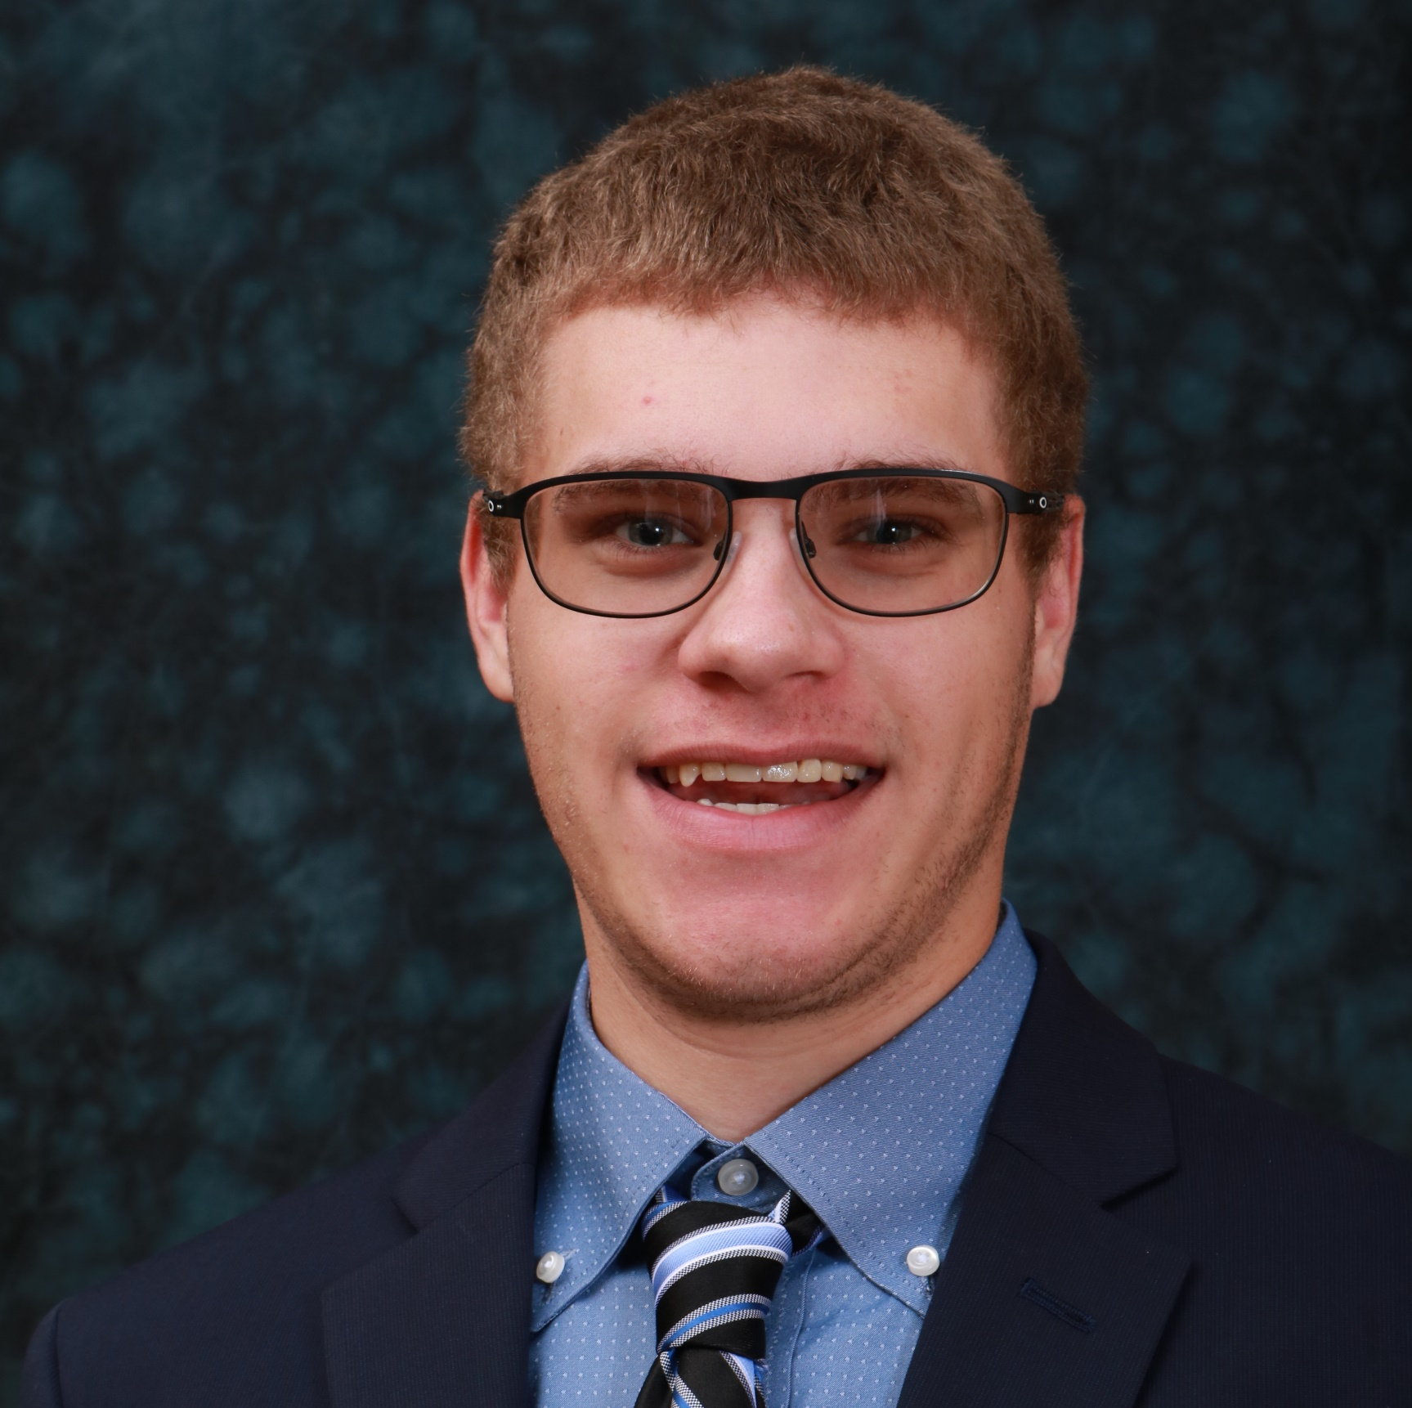
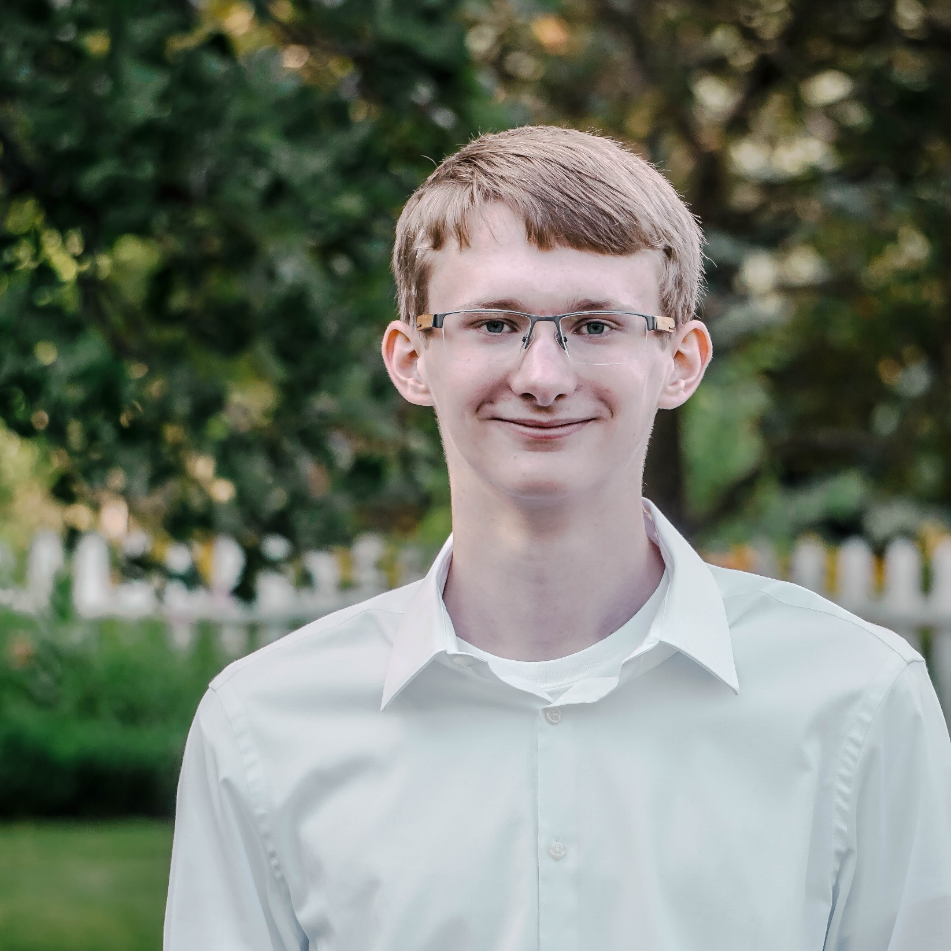
About our team
Our team is composed of three students from Dakota State University.
Andrew Rotert – Computer Science, Mathematics
Nick Sandison – Computer Science, Mathematics
Ryan Morganti – Cyber Operations, Mathematics

Slide 3
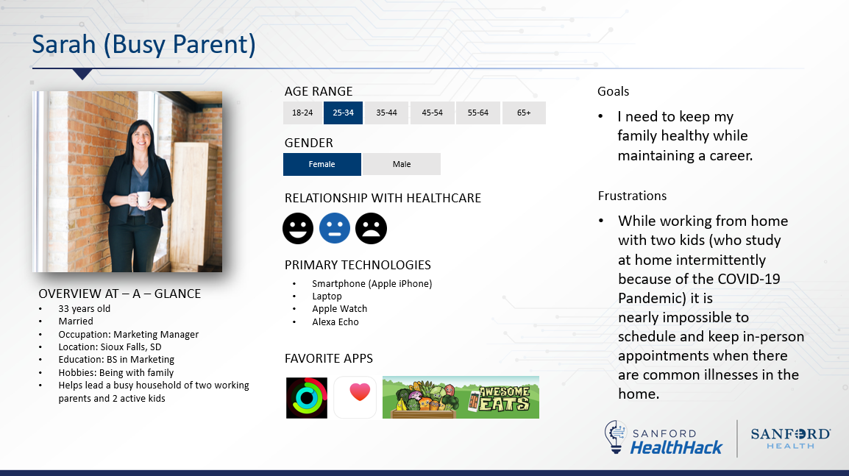
User Persona

Slide 4
Strategy
When appointments are not able to be made or kept, for a variety of reasons, health issues may be overlooked.
Our projects seeks to implement a solution to provide relevant medical knowledge to inform a user if a doctor’s visit is necessary.

Slide 5
Overview
For busy parents like Sarah, scheduling appointments to check out symptoms can be impossible
Our project is an early warning system and risk identifier that is accessible anywhere via mobile app
Our projects utilizes augmented reality (AR) technology to scan affected areas on the user. This scan is mapped into data points that an artificial intelligence (AI) model can analyze

Slide 6
What Went Well & Not Well
Well
Implementing augmented reality as a native iOS application
Not Well
Implementing machine learning to integrate with our app

